Slide 1


Dish Delights
Make every dish delightful
Team member:
Tangchao Li, Tingyi Ruan, Libo Yao

Slide 2
Presentation overview
1
2
3
4
5
Project Introduction
Basic
Requirements
Technical Implementation and specialties
Demo
Q&A

Slide 3
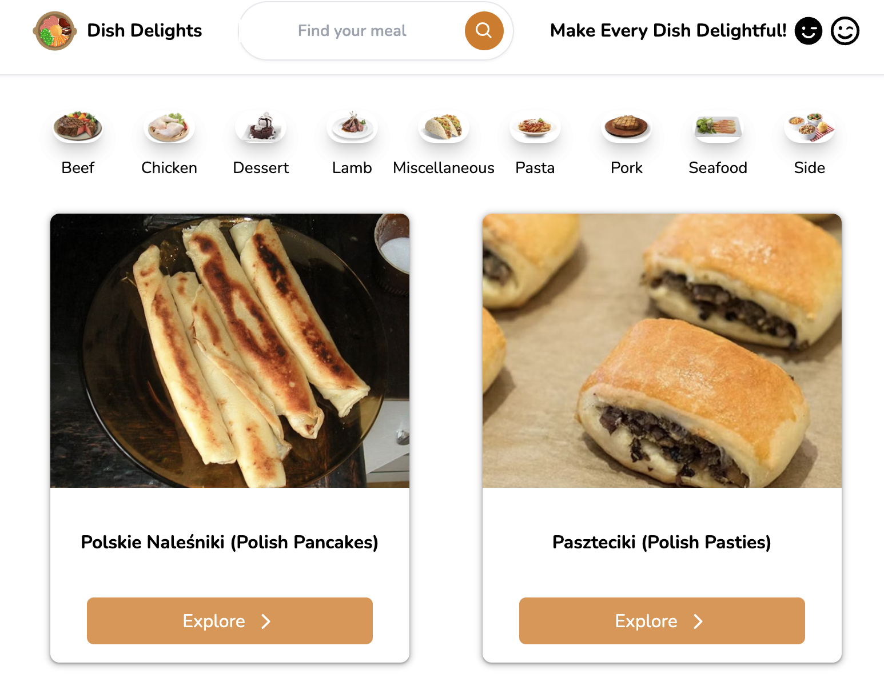
Introduction
What the project is about?
Our app offers a comprehensive library of cooking recipes, covering a wide range of meals.
Why it was choosen and for whom?
As newcomers to foreign countries, we discovered that cooking requires creativity and effort. Hence, we envisioned a cooking website that would allow users to search for recipes based on available ingredients and desired cuisine types.

Slide 4
Persona analysis for Mia and John
John
Mia
International student
Engineer
Age
22
28
Sexual Orientation
Female, straight
Male, gay
Culture/Language
Originally from China, speaks Mandarin and English
American, speaks English
Familiarity with Technology
High; frequently uses apps and websites for daily needs
integrates technology into all aspects of life
Contextual Factors
Often in a hurry, searches for quick recipes
Prefer deciding what to eat and buy materials in advance
Usage Context
Prepares meals in a kitchen with limited resources
Often plans meals around his work schedule
Preferred Website Usage
Searches recipes based on available ingredients; appreciates easy-to-follow steps
Prefers using advanced search filters to find recipes that can be made within 30 minutes or less

Slide 5
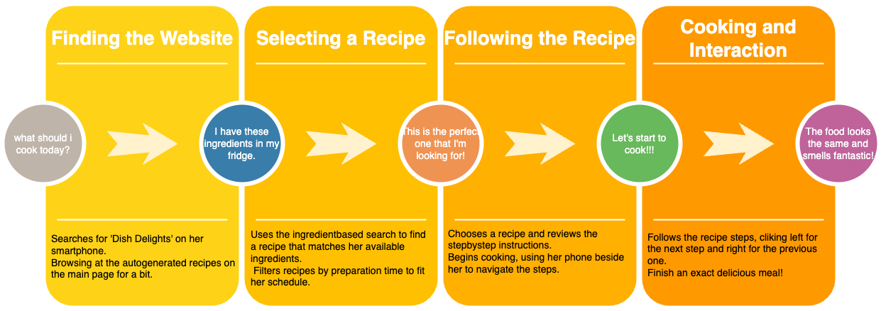
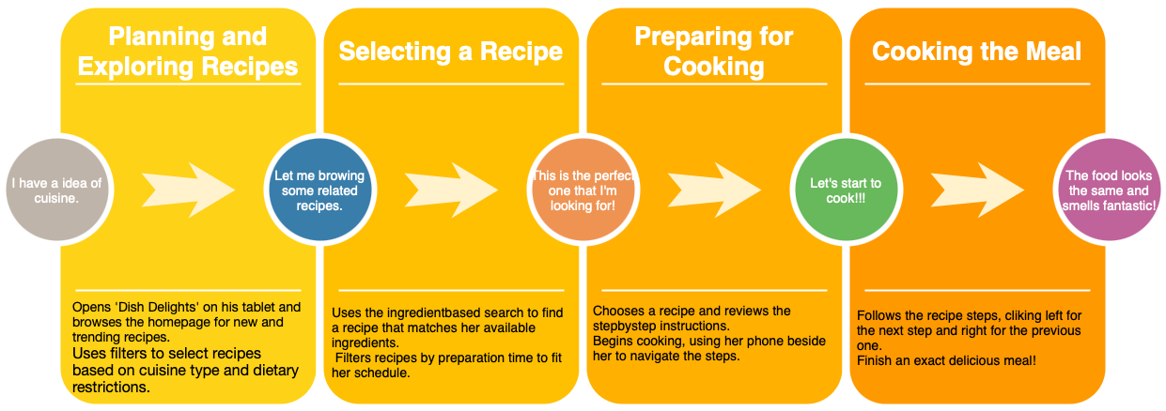
User Journey

Slide 6
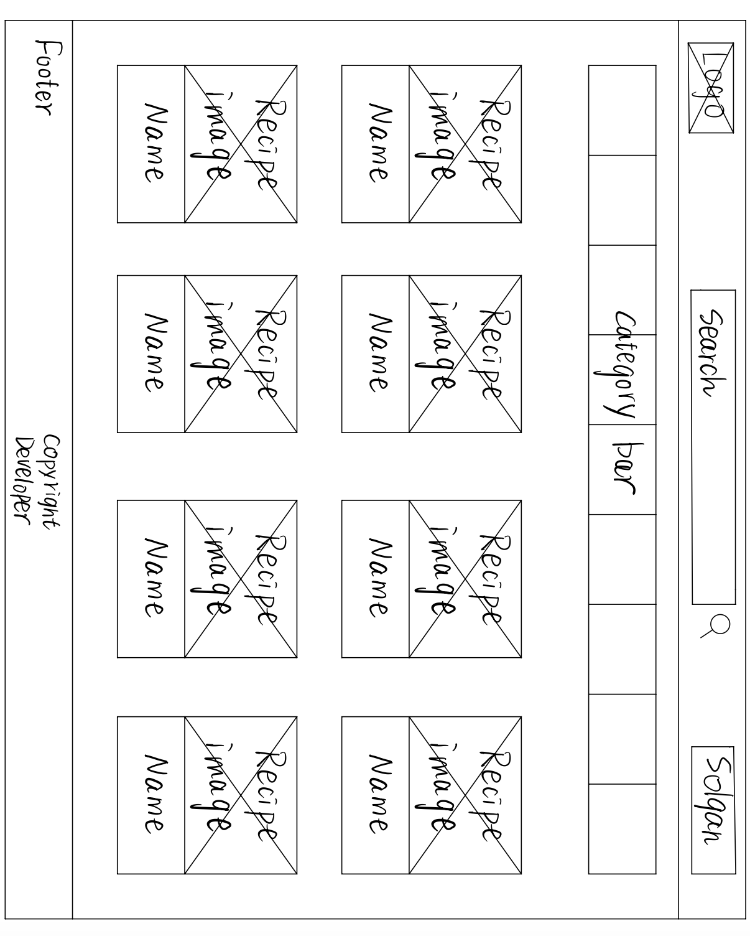
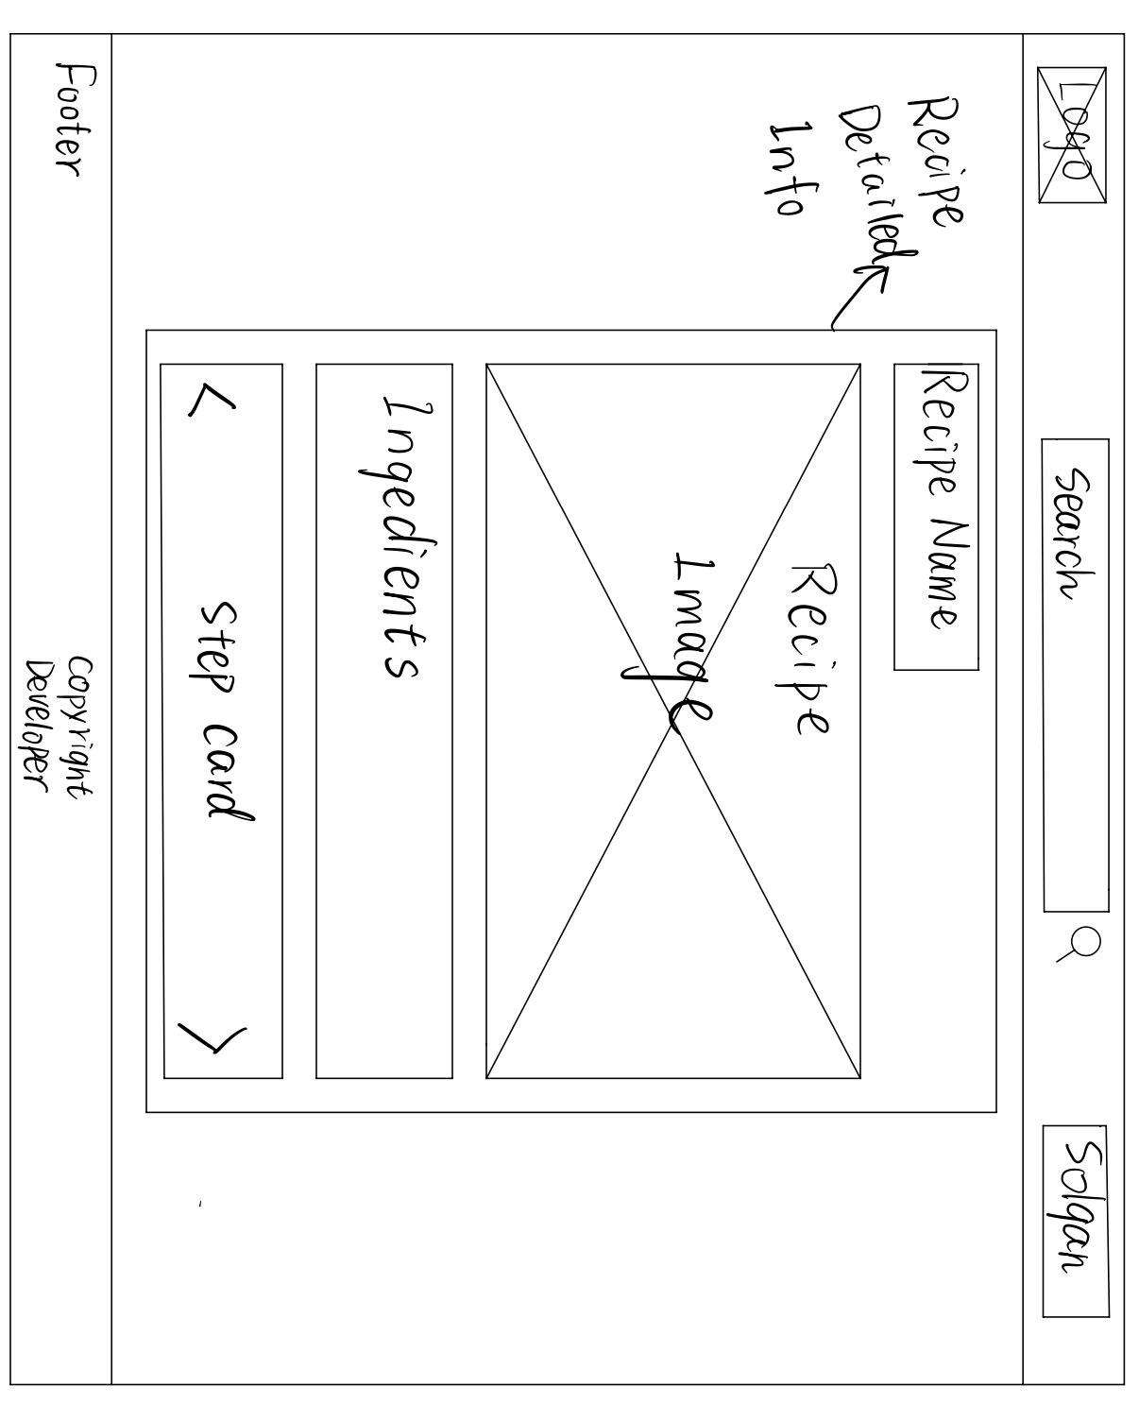
Low-resolution mockups

Slide 7
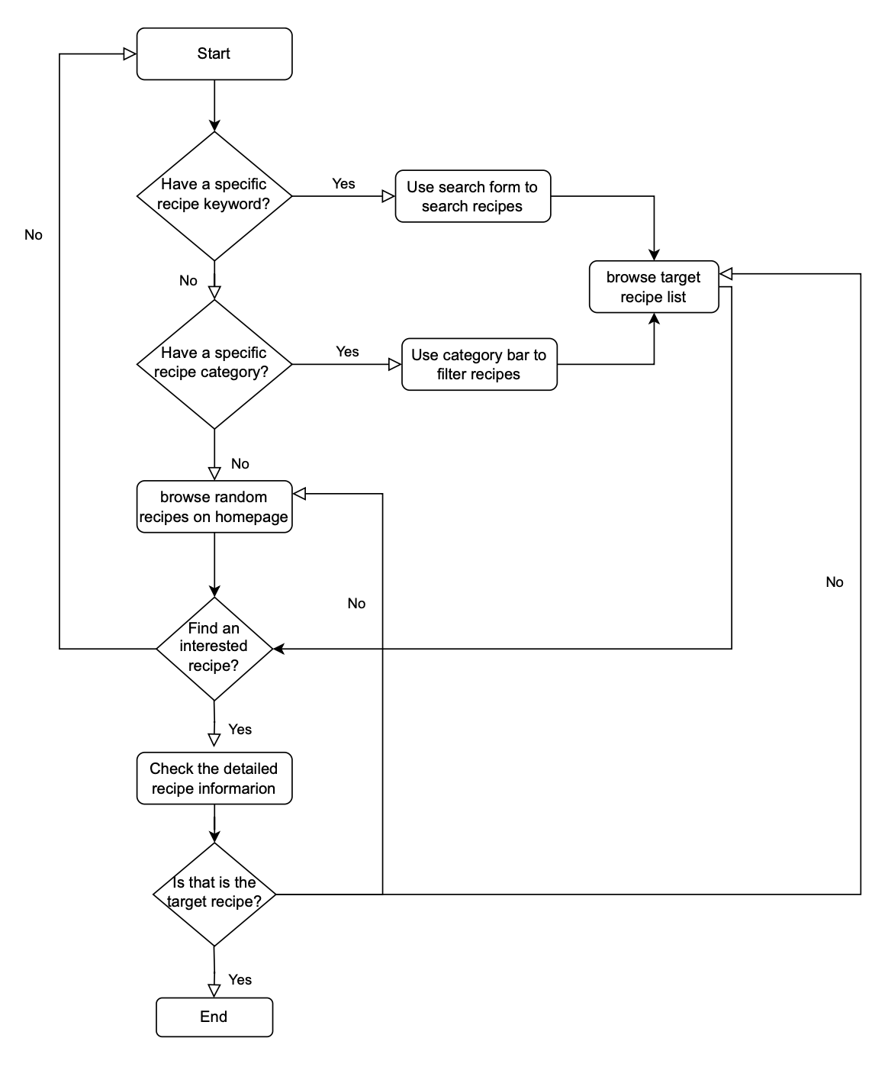
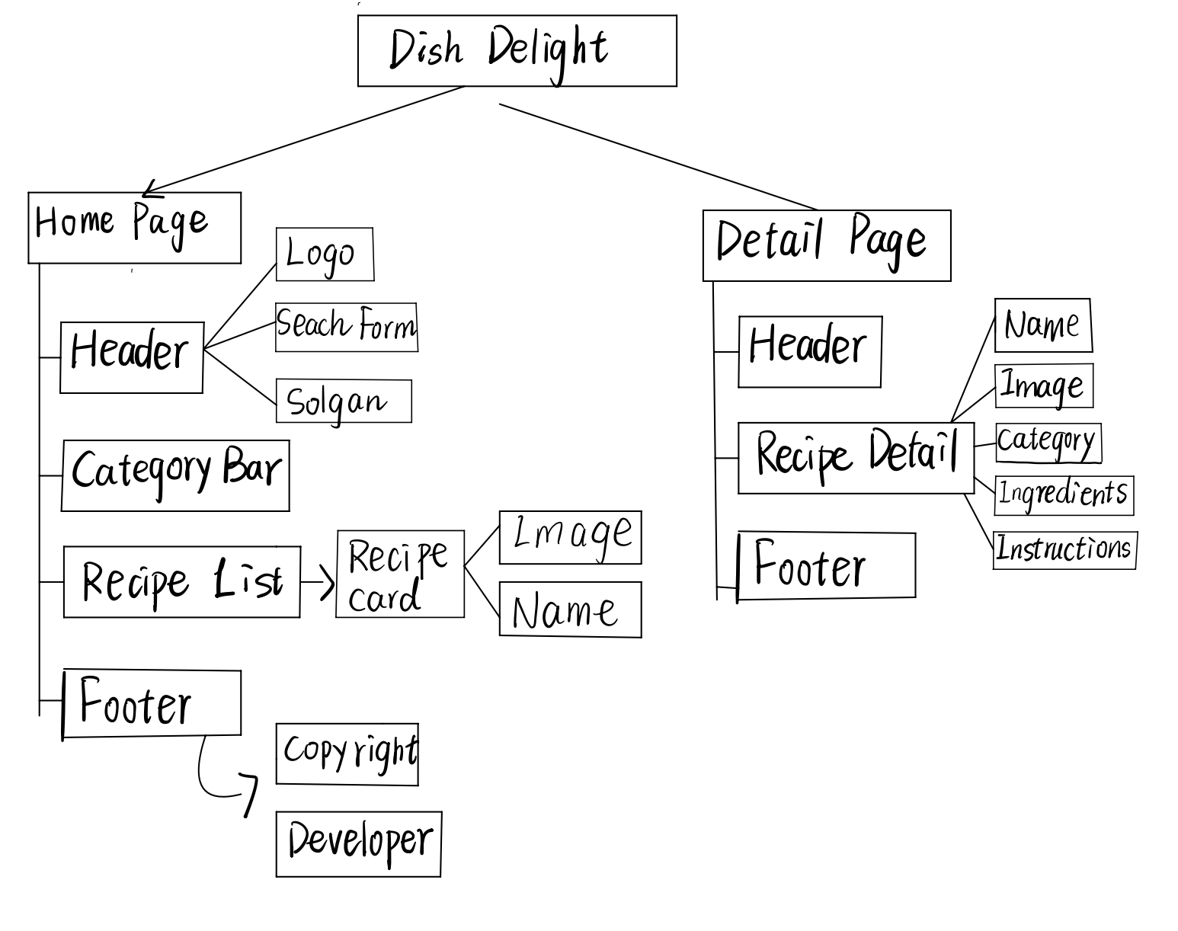
Websites Map

Slide 8

Typography and Color
Typography: Nunito
Readability
Modern Appearance
Theme color: Amber series
Warm: The amber color palette creates a warm and comfortable feeling
stimulates appetite

Slide 9
Technical Implementation and specialties
Front-end Framework
specialties
Our front-end is built using modern JavaScript frameworks Next.js and React.js, ensuring a responsive and visually appealing user interface.
SEO
Accessibility
Javascript Mastery
API Integration

Slide 10
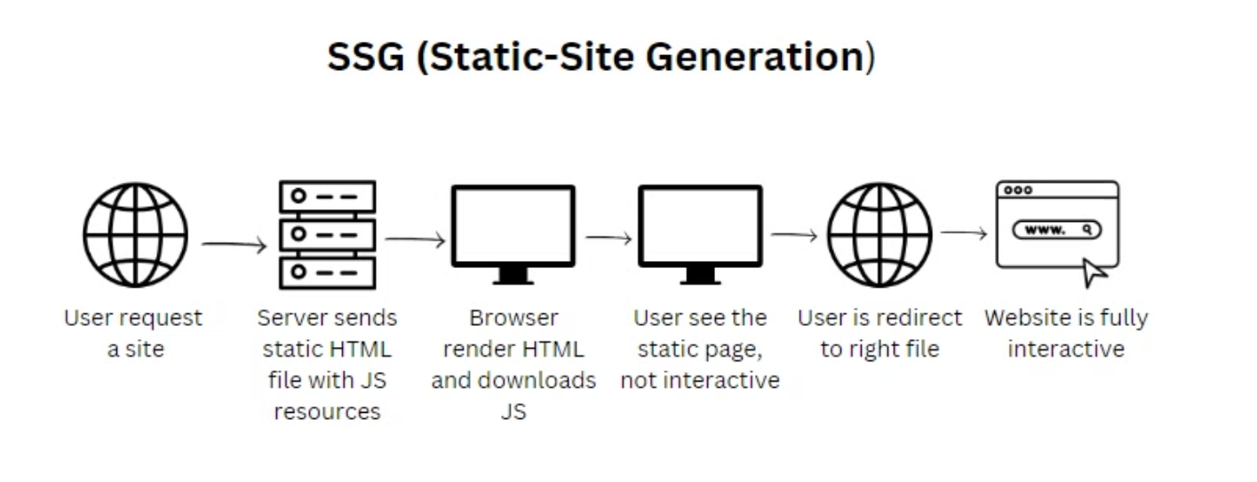
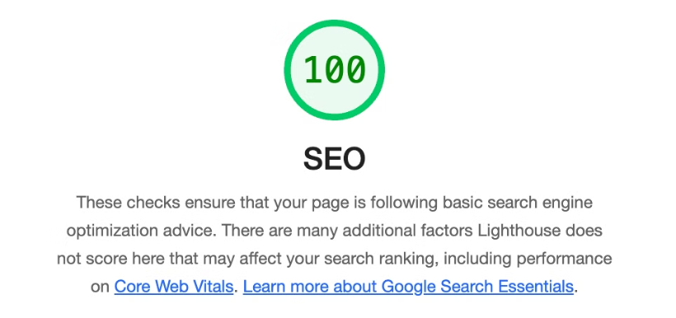
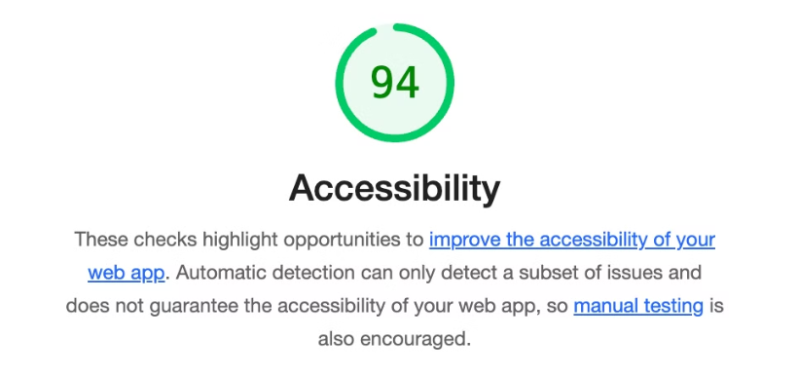
SEO and Accessibility

Slide 11
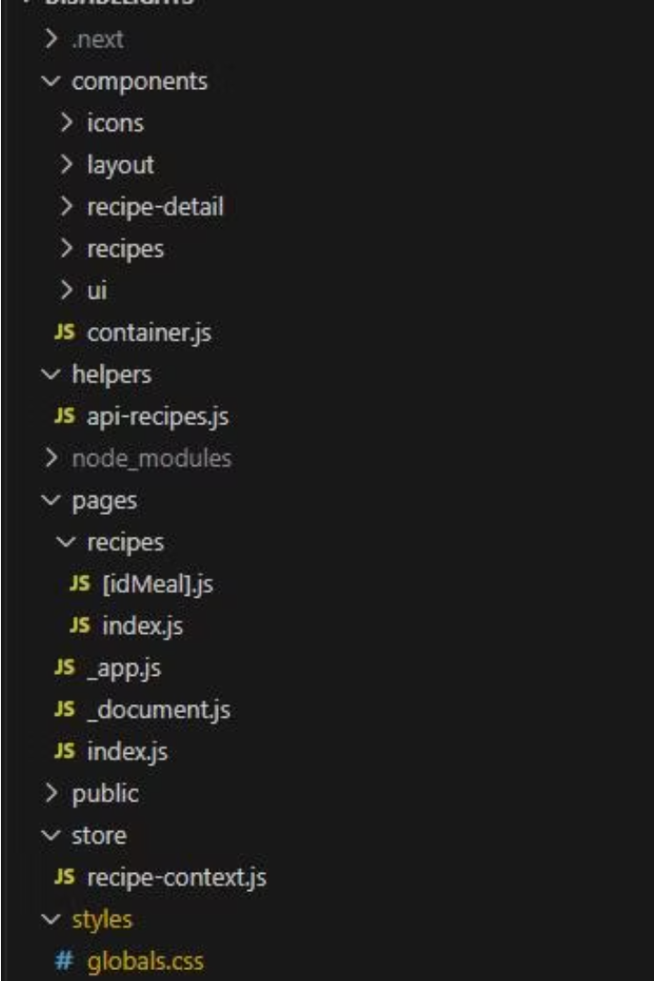
Javascript Mastery
file structure for next.js file routing

Slide 12
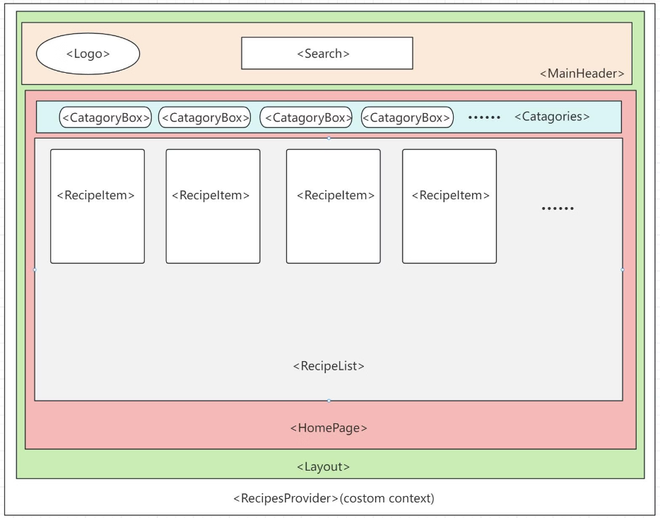
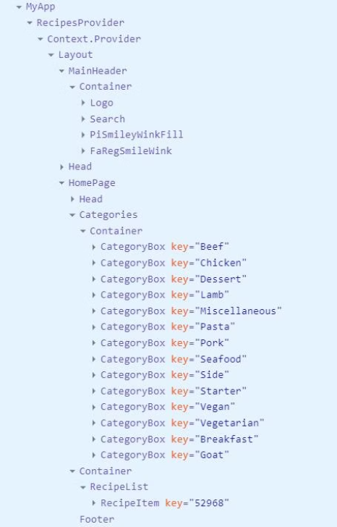
Component Trees- Home Page

Slide 13
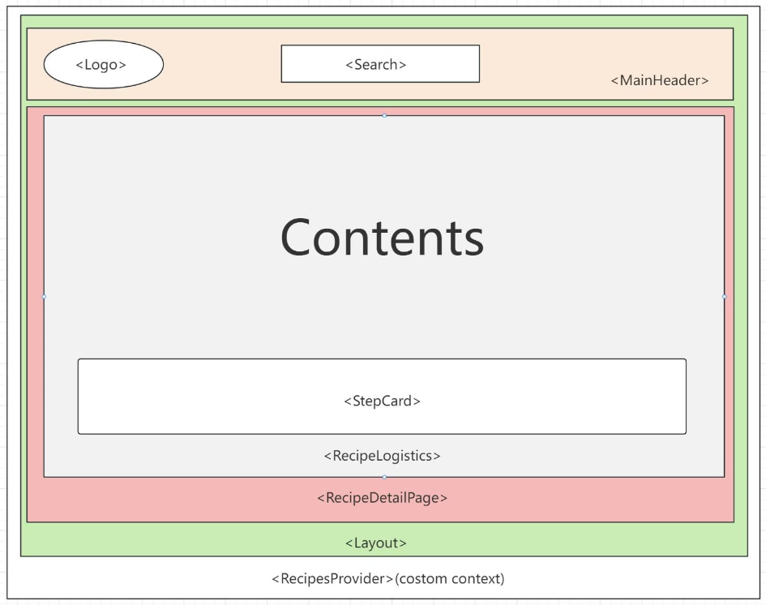
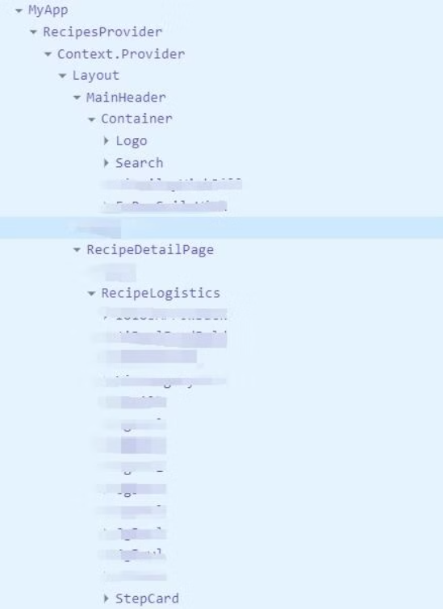
Component Trees- Recipe Detail Page

Slide 14
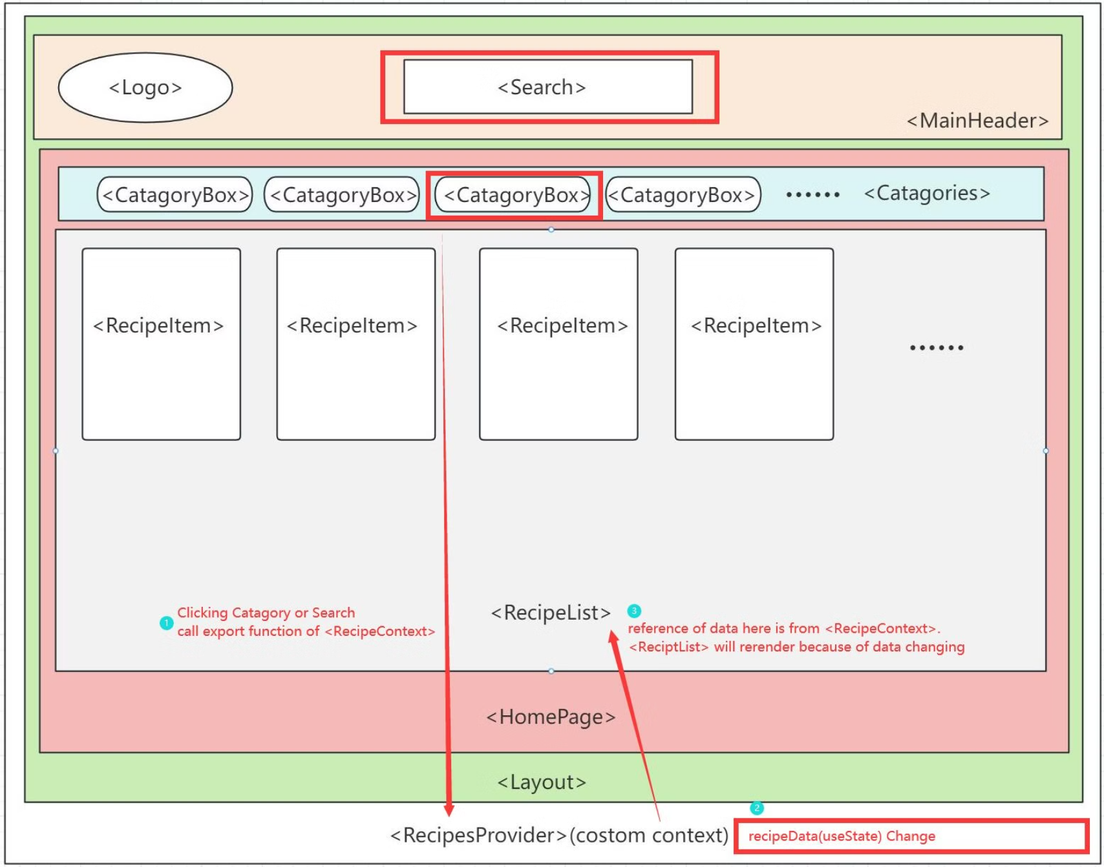
Components
Communication
Solution

Slide 15
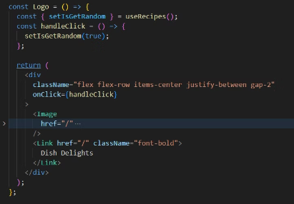
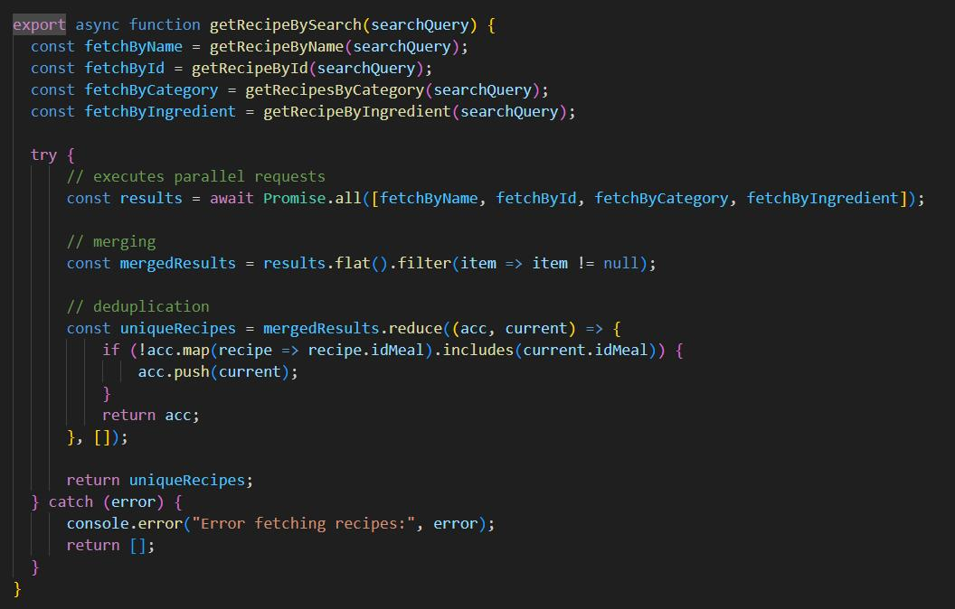
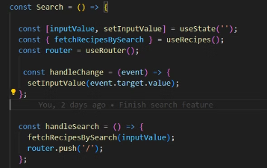
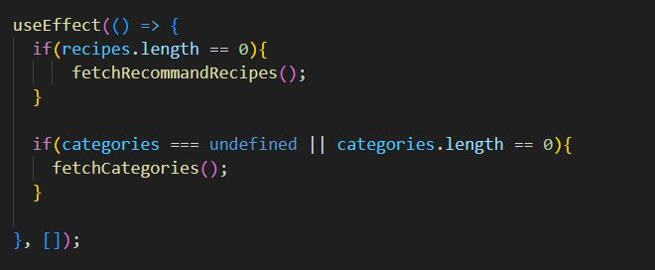
Other Techniques
Parallel Data Requests using Promise.all.
Usage of <Link> Component
and React Router
Asynchronous Data Rendering with useEffect

Slide 16
API Integration-Usage and Justifications
Base URL & Functional Goals
Search Functionality API
Category Filtering API
www.themealdb.com/api/json/v1/1/
filter.php?c=Seafood
The homepage recipe recommendation aims to suggest options to users unsure of their culinary choices.
By name: search.php?s=Arrabiata
By ID: lookup.php?i=52772
This API endpoint is used for filtering recipes according to the category, area, or ingredients, which aids users in displaying recipes belonging to selected criteria.
By area or ingredient: filter.php?a=Canadian or filter.php?i=chicken_breast
Displaying all categories for quick filtering assists users with specific preferences to swiftly find recipes.
The Search API endpoint is used for implementing the search functionality within the application, allowing users to find specific recipes by name or ID.
The search functionality is designed to help users quickly locate particular dishes, and the detailed recipe display function presents comprehensive content to the user.
Random Recipe Selection API
Categories Listing API
Recipe Detail API
randomselection.php
categories.php
lookup.php recipe ID as a parameter.
This endpoint is crucial for displaying detailed content upon clicking a recipe card.
fetches 10 random recipes, provide homepage recommendations for users uncertain about what to cook.
Used to display all recipe categories for quick user filtering and selection.

Slide 17
API Integration-API Considered But Not Used
Ingredients Listing API:
Reason for Exclusion:
www.themealdb.com/api/json/v1/1/list.php?i=list
While this endpoint provides a list of all recipe ingredients, it only offers names and descriptions without images. The extensive variety makes it less suitable for categorical selection like the categories feature. Moreover, if users need to find recipes containing specific ingredients, the search function already serves this need, making this API superfluous for the project.

Slide 18
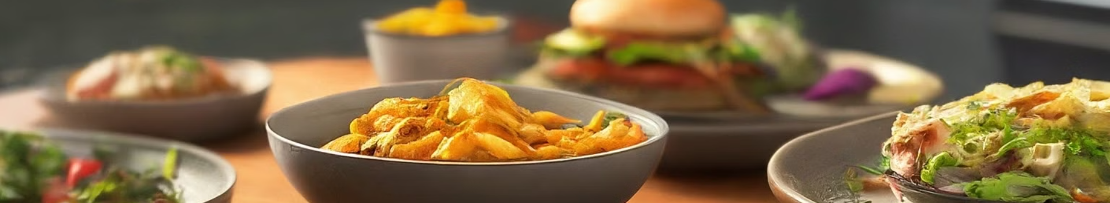
Demonstration
websites link: https://dish-delights.netlify.app/

Slide 19

Conclusion and Future
1
What we learned
The importance of user centered design
Responsive layouts
2
User module
Login
Register
3
Social Community
Comments
Upload

Slide 20

Q & A Session
Please feel free to ask any question!

